Slide 1
Prequel for Class 12
ENVE 644
April 8, 2002

Slide 2
Overview
Planning “Permits”
Are their endangered species on our project?
Cross salmon stream?
Entire EA/EIA/FONSI process
“Let’s get started” permits
CWA
SWPPP
404
Point source
CAA
Others

Slide 3
Overview cont.
Operations - Permits and Issues
Unlike SWPPP, things did not know about
Finding contamination as you work
Asbestos, lead, pcb, PFOS, CoM (contaminant of the month)
Making it yourself
Spills and Accidents

Slide 4
Common with other permits
Extensive regulations now apply
Coordination with agencies
Often the public is involved
Good time to talk about ETHICS

Slide 5
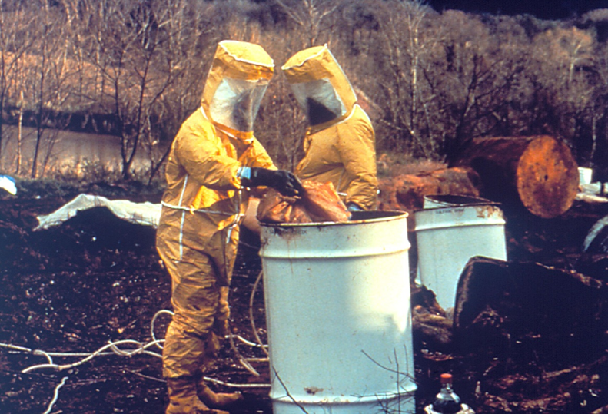
CERCLA
Contaminated sites you didn’t know about

Slide 6
What you don’t know…
If your project is the clean-up of a contaminated
site, you know what you are getting into – mostly.
What if you stumble into contamination you did
not know about?
Might be natural
https://www.tandfonline.com/doi/abs/10.1080/15459620802289941?mobileUi=0&journalCode=uoeh20
Or anthropogenic –
Or if you are the one who does some contaminating

Slide 8
Laws
CERCLA
Comprehensive Environmental Response, Contamination, and Liability Act
AKA Superfund
Other laws as well
Two main CERCLA divisions for our projects
Finding old contamination
Making new – typically a spill

Slide 9
Phase I and Phase II
Best bet with old contamination is to find it before you start.
Common with Real Estate transactions, so here is a good start.
https://www.youtube.com/watch?v=BvbsFz8Z2SU

Slide 10
Spills
No problem, if you put a liner down before you spill.
You didn’t??
https://www.youtube.com/watch?v=GrIvhuX5uZ0
https://dec.alaska.gov/spar/ppr/spill-information/reporting
(look at reporting requirements)

Slide 11
What is “hazardous?”
A hazardous material is any item or agent (biological, chemical, radiological, and/or physical), which has the potential to cause harm to humans, animals, or the environment, either by itself or through interaction with other factors.
40 CFR 355 Appendix A has nice list:
https://www.law.cornell.edu/cfr/text/40/appendix-A_to_part_355

Slide 12
RQ
https://www.ecfr.gov/cgi-bin/text-idx?SID=5eb9206a60662143cb26a1b0a7263e74&mc=true&node=se40.28.302_14&rgn=div8
See RQ, reportable quantities

Slide 13
Oil
Generally exempt from CRCLA, but
Oil ingredients, like benzene are included
So in Alaska, you must report any amount of hazardous material spilled,
But only must report to federal EPA if it is over RQ
Memo: always put down a liner before you spill.

